Slide 1
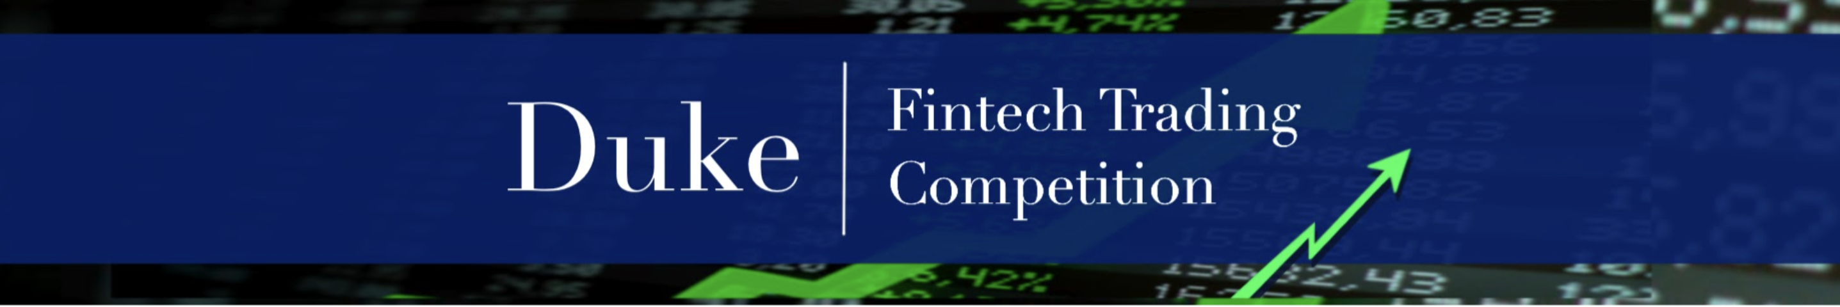
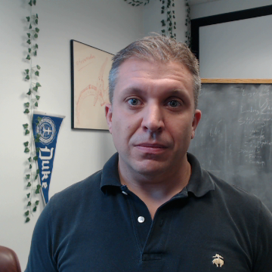
Scoring & Ranking
Notes:
I’m Jake Vestal and in this video I’ll explain how traders in the 2023 Duke FinTech Trading Competition are scored and ranked.

Slide 2
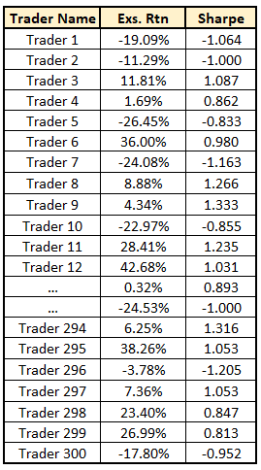
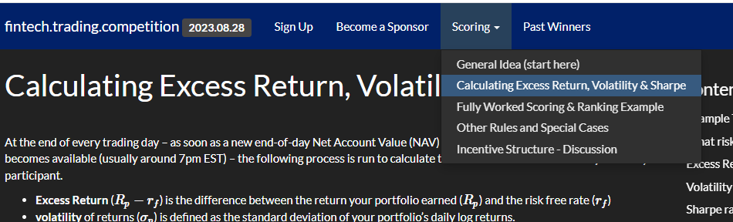
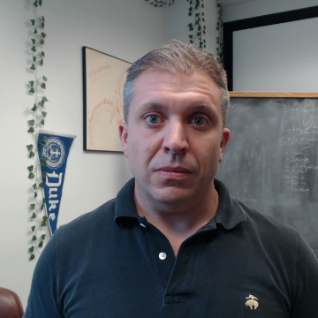
Start:
Calculate Excess Return and Sharpe ratio for each trader in the competition.
Performed daily as data are available
Based on end-of-day Net Asset Value (NAV) starting Day 1 of the competition.
See the “Calculating Excess Return, Volatility and Sharpe” page under “Scoring” for details.
Notes:
The system starts by querying every trader’s end-of-day Net Asset Value starting from the first day of the competition.
Based on that data, excess return and Sharpe ratio is calculated for each participant.
To see in detail how those values are calculated, visit the Calculating Excess Return, Vol & Sharpe section on the website, which you can find HERE under “scoring”.

Slide 3
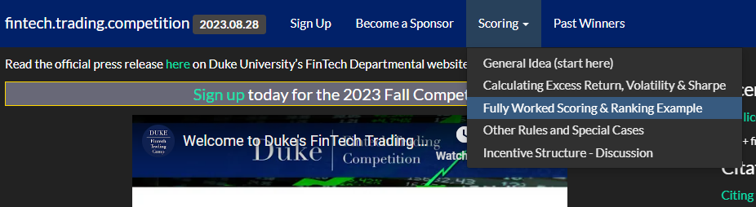
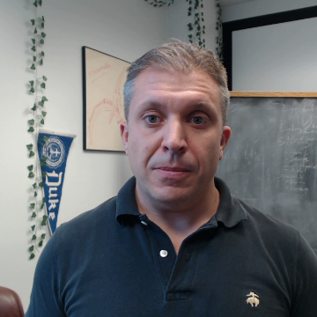
For the remaining steps, you can see a fully worked example for the ranking & scoring of a set of traders by visiting the “Fully Worked Scoring and Ranking” page under “Scoring”.

Slide 4
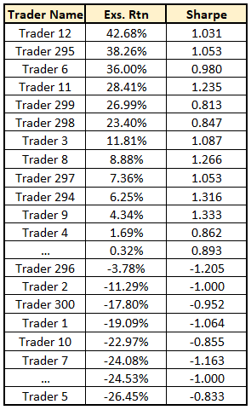
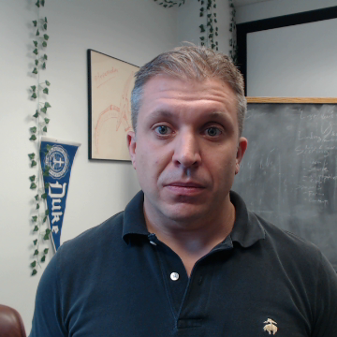
Step 1:
Sort the traders by decreasing excess return.
Fully worked example available here:

Slide 5
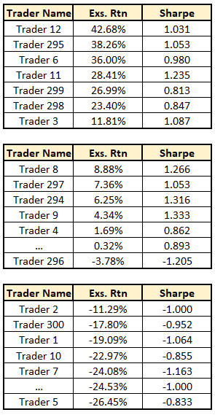
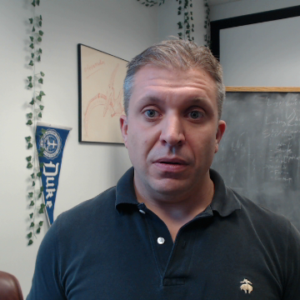
Step 2:
1st Bracket
Break traders into n brackets
Fully worked example available here:
2nd Bracket
nth Bracket

Slide 6
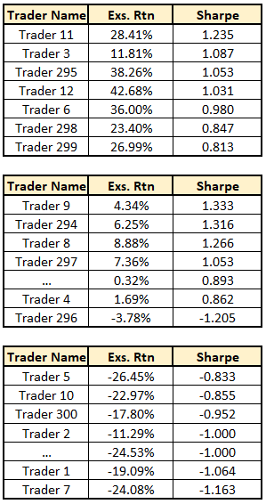
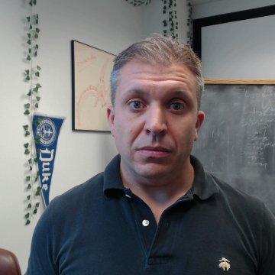
Step 3:
1st Bracket
Sort by Sharpe (decreasing) within each bracket
Fully worked example available here:
2nd Bracket
nth Bracket

Slide 7
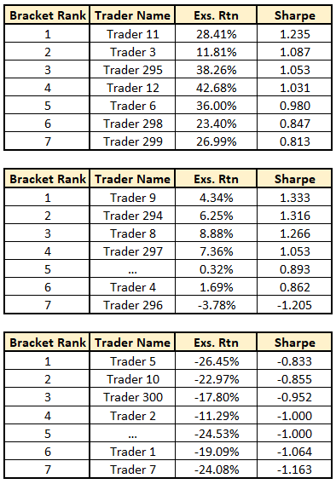

Step 4:
1st Bracket
Assign ranks within brackets
(your “bracket rank”)
Fully worked example available here:
2nd Bracket
nth Bracket

Slide 8
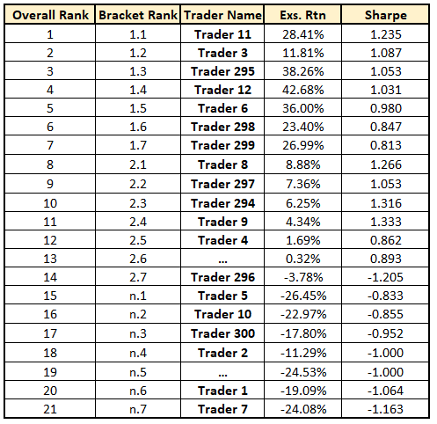
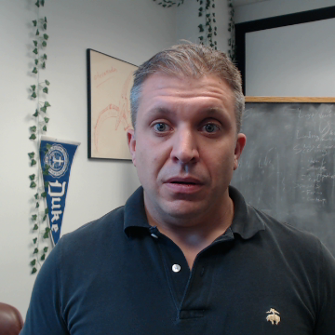
Step 5:
Recombine and assign overall rank
→ The “overall rank” is your rank for the entire competition.
Fully worked example available here:

Slide 9
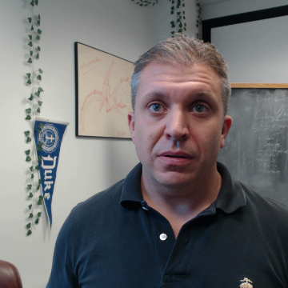
Useful Properties of this system:
Traders are rewarded for returns, but penalized for volatility
Cash prizes are only awarded to the top half of the top bracket
To get into the top bracket, you need a high return
But to place highly in the top bracket, you need a low vol!
Bracket system keeps traders competing
Even if you can’t win overall, you can chase top spots in your bracket

Slide 10
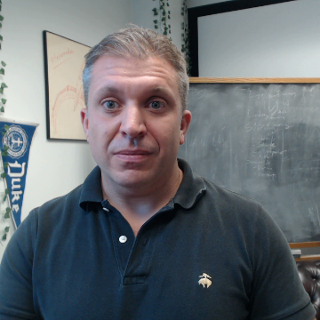
Thank you!
Traders may reach out via the Discord channel with further questions.

